Slide 1
BARC Tube Bending Week 4

Slide 2
Checklist
Process: Manual Edge detection Smoothing edges Fitting lines to straight sections Angle Calculation Part 1 ( Bends 1 & 2) Part 2 ( Bends 2,3 & 4) Automated Edge detection Smoothing edges Fitting lines to straight sections Angle Calculation Part 1 ( Bends 1 & 2) Part 2 ( Bends 2,3 & 4) | Varying Parameters: Background Color Background Brightness Distance to LED box Height of camera Camera Orientation Lighting (Front vs Back) Different cameras/lenses Adding noise (non-ideal lighting conditions) No. of Cameras

Slide 3
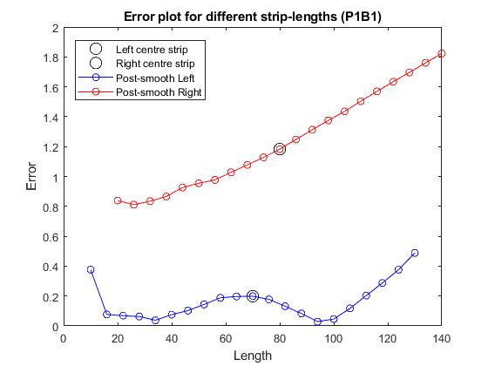
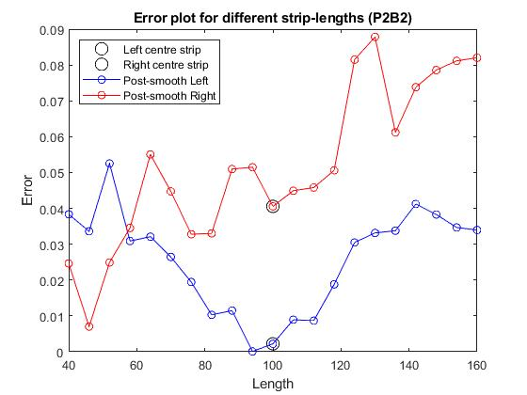
Last Week Result: Angle Error plots
Changing the length of the data points gives us an idea of the angle error we get
No general trend observed because it depends on the edge roughness and camera resolution

Slide 4
New Approach: Fitting Error
Start from the middle of the edge data points.
Increase the number of points for line fitting, get the fitting error and the angle error.
Hopefully the minimum angle error should be corresponding to the minimum fitting error.

Slide 5
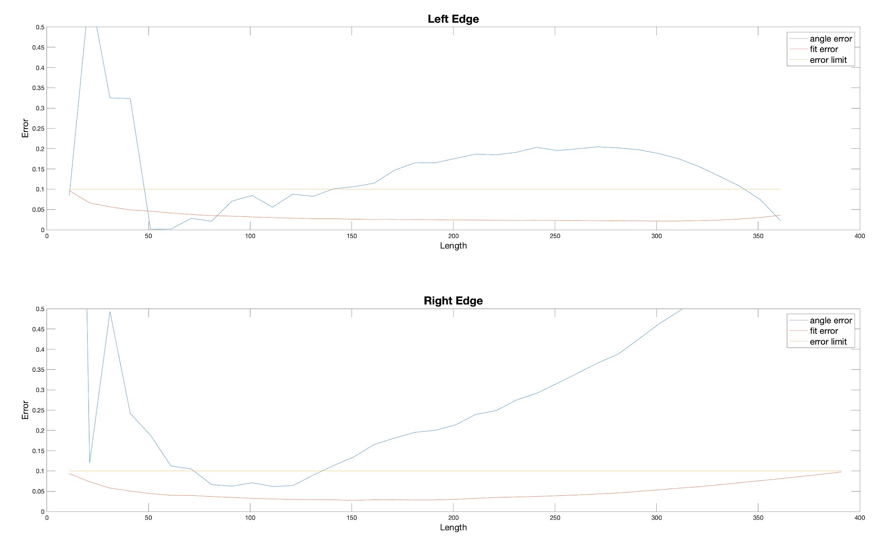
New Approach: Fitting Error
P1B1

Slide 6
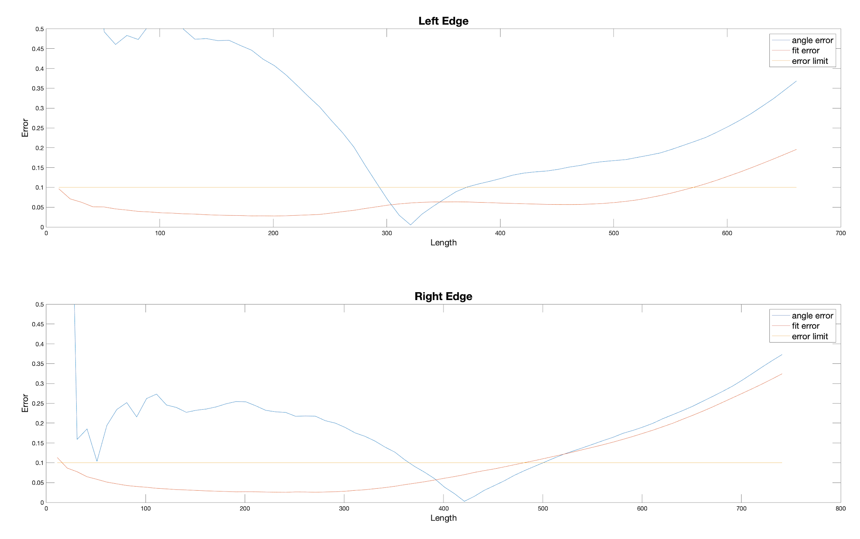
New Approach: Fitting Error
P1B2

Slide 7
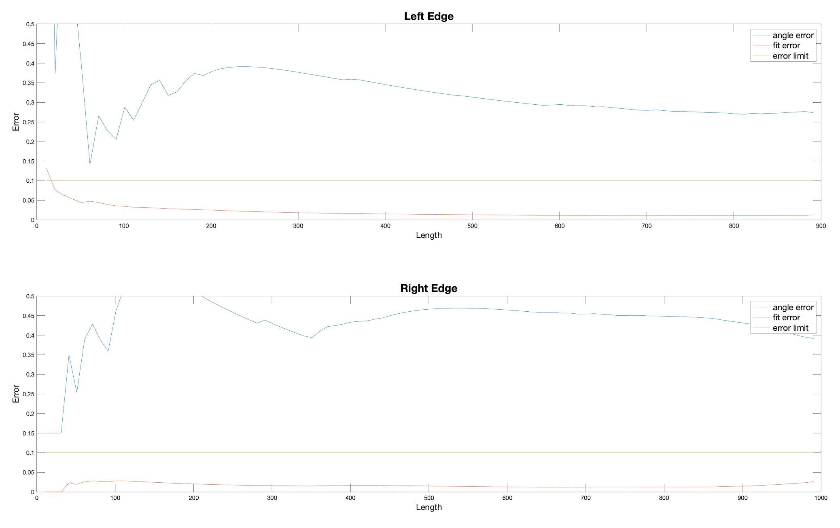
New Approach: Fitting Error
P2B1

Slide 8
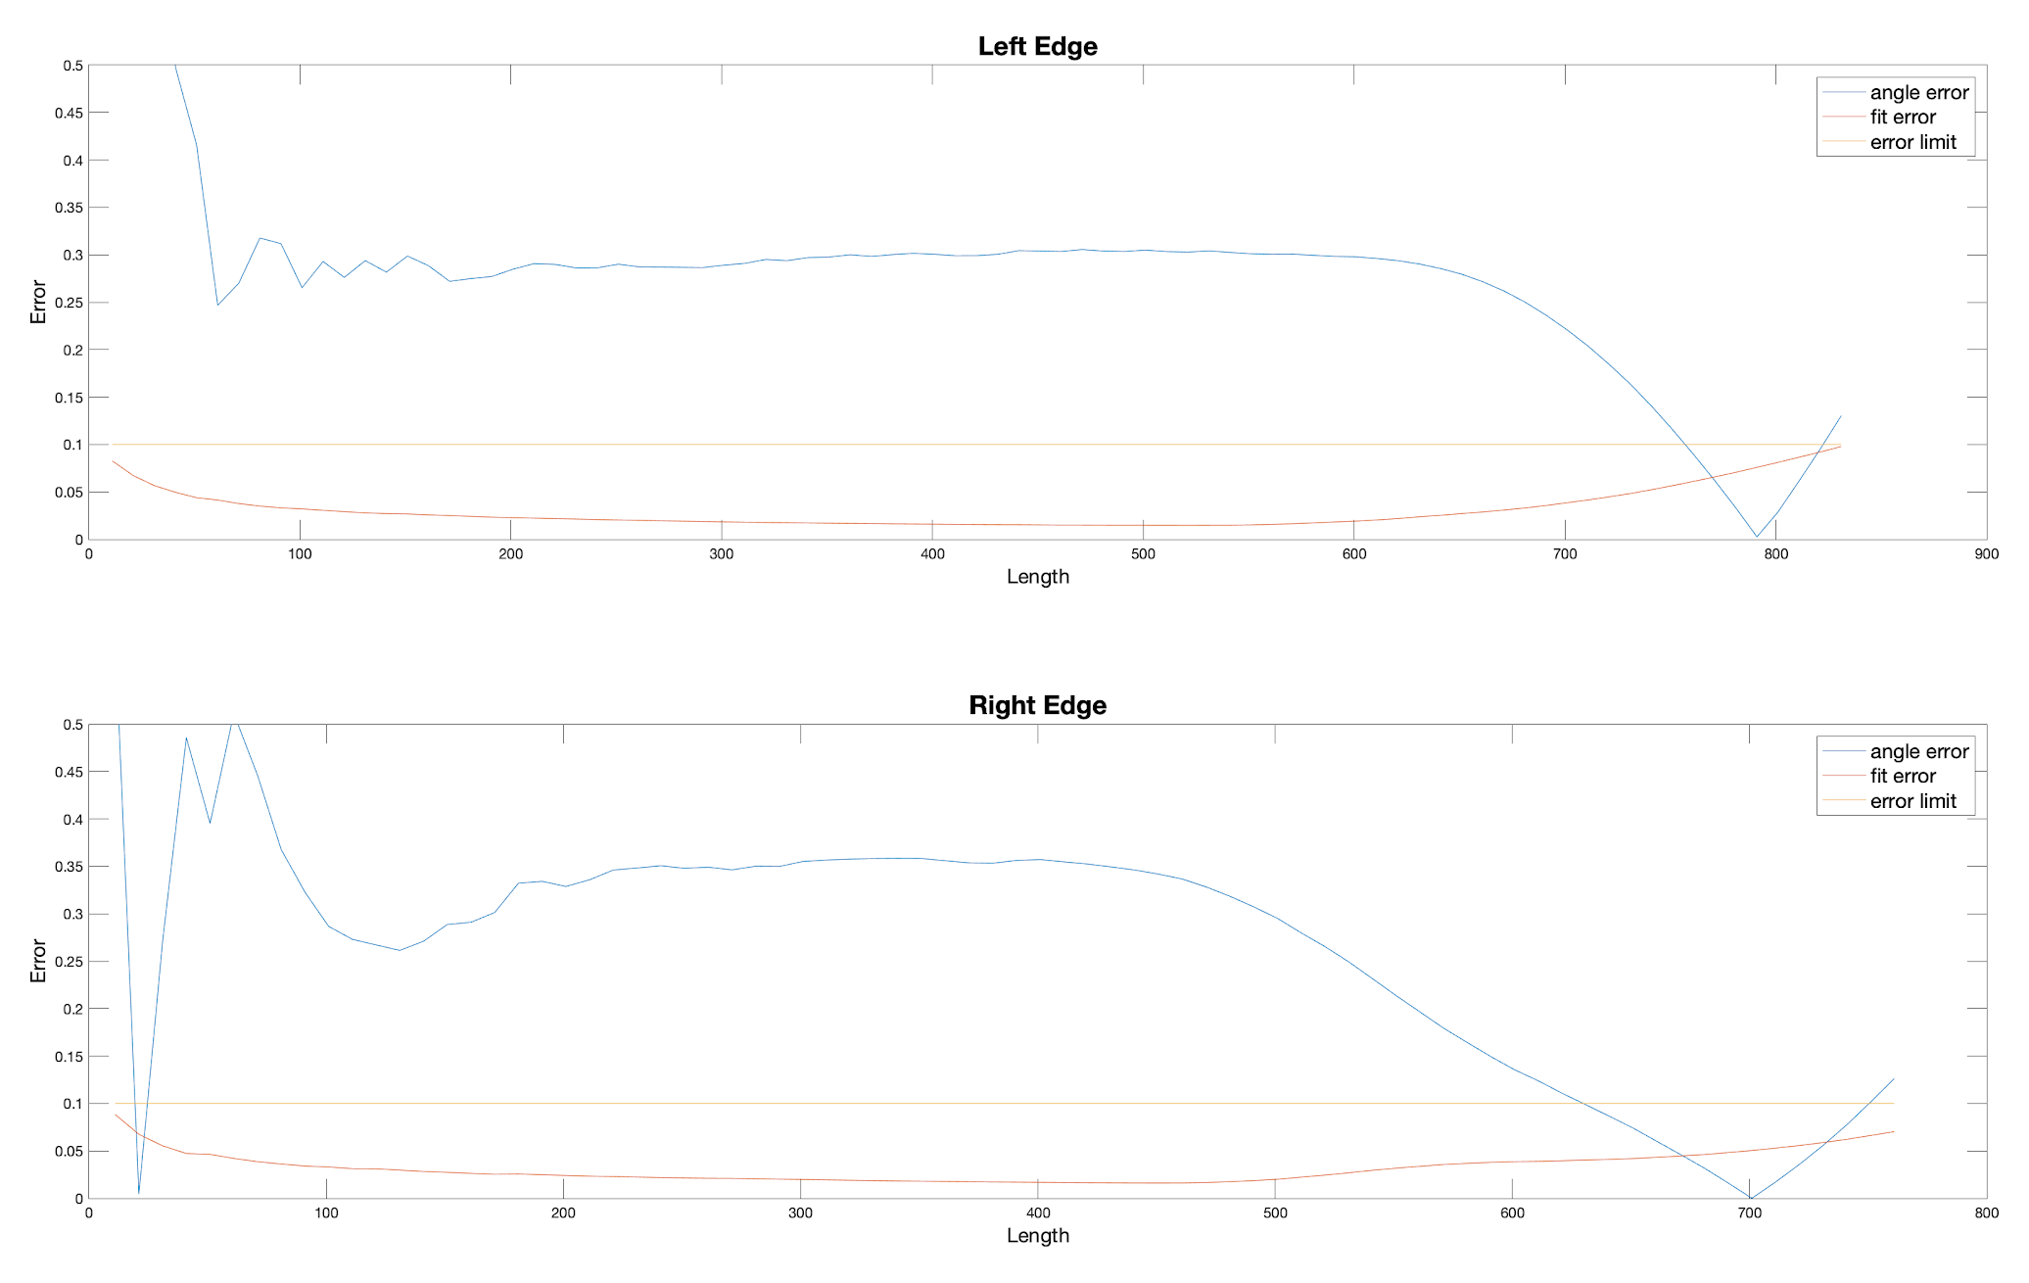
New Approach: Fitting Error
P2B2

Slide 9
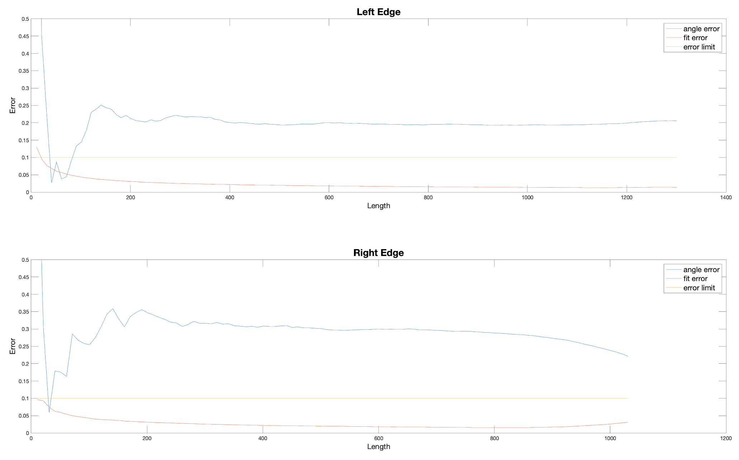
New Approach: Fitting Error
P2B3

Slide 10
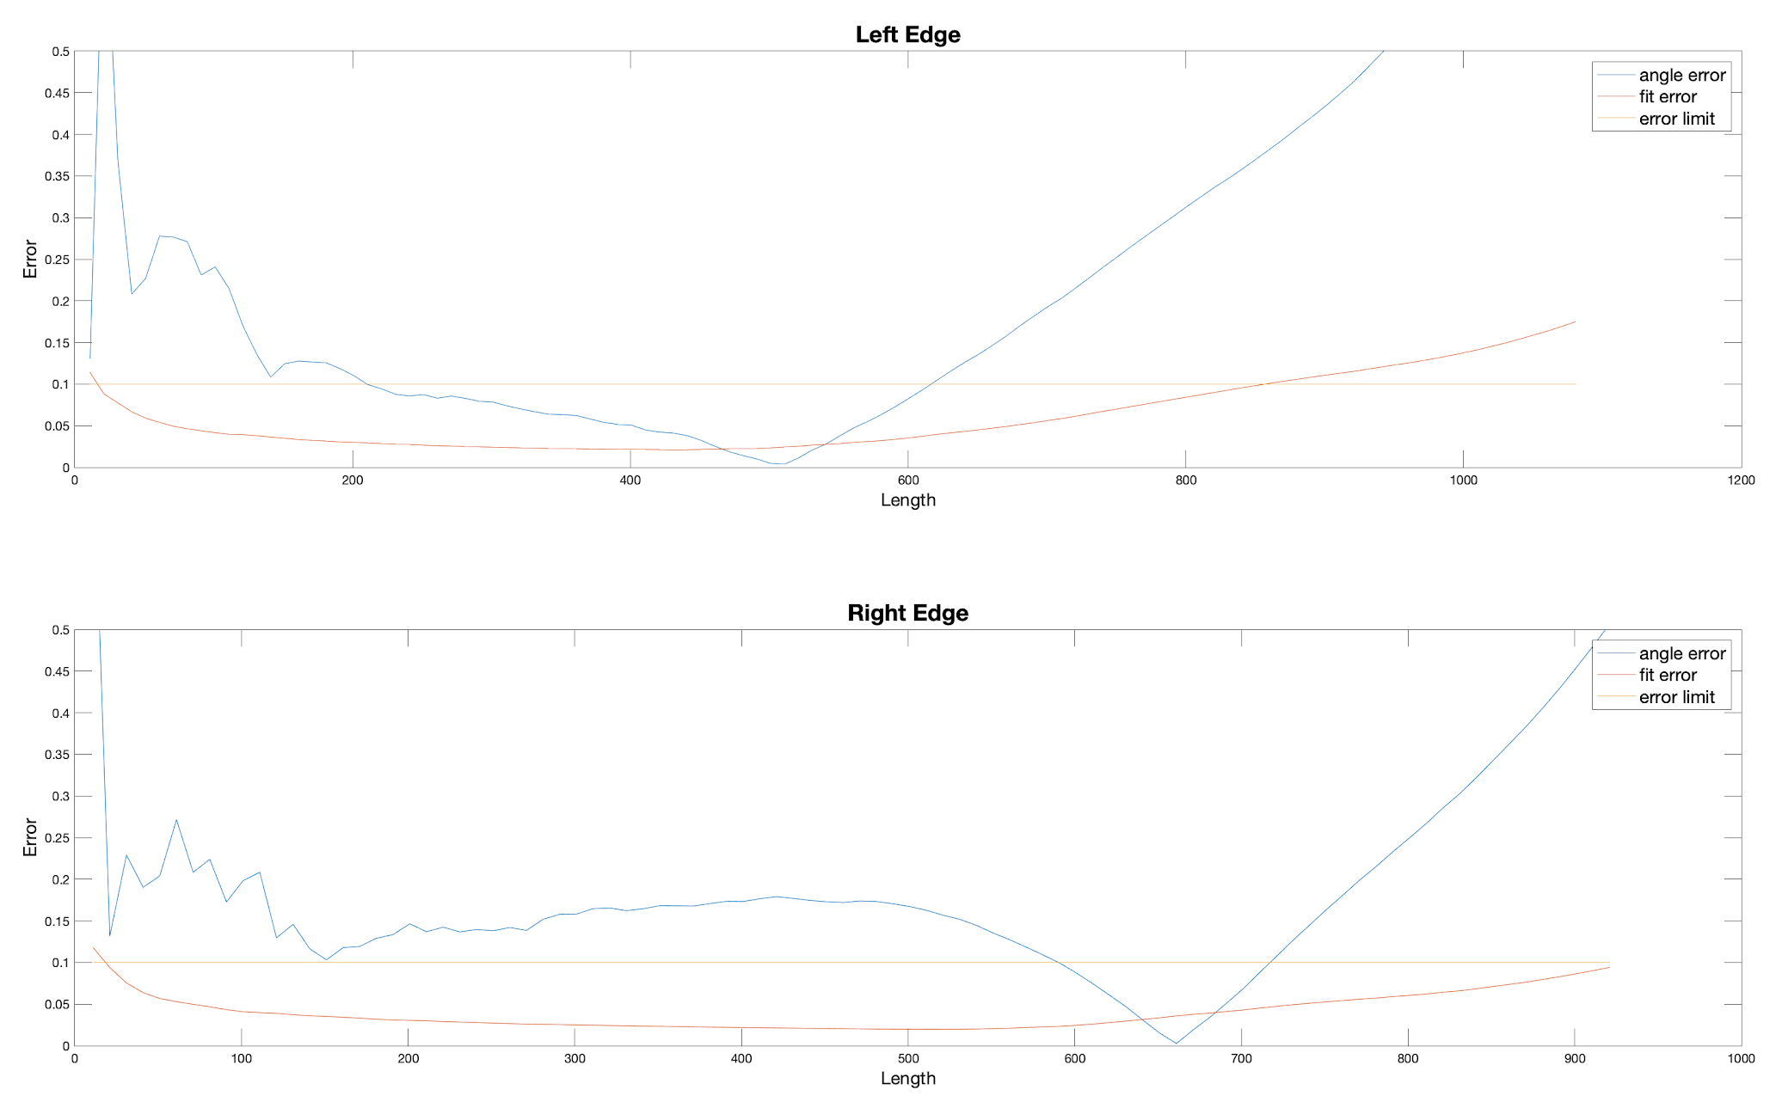
New Approach: Fitting Error
P2B4

Slide 11
Result
The left edge gives less error than the right edge in most cases.
The number of data points, the fitting error and the angle error seems irrelevant with each other.
Right now it is safe to say that 0.5 deg accuracy can be reached.

Slide 12
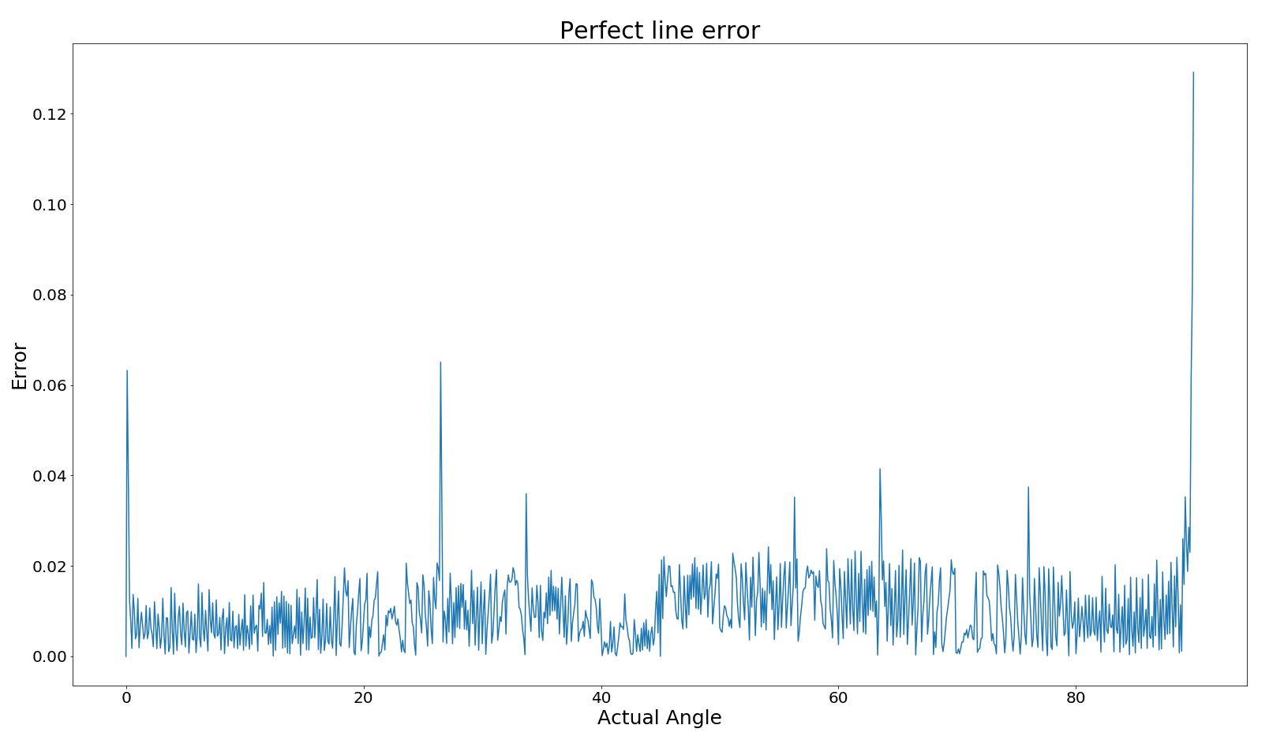
Perfect Line Test
For different angles, we draw a corresponding line on the image.
Then use these data points for line fitting.
We found that even for the perfect line, the error was not negligible.

Slide 13
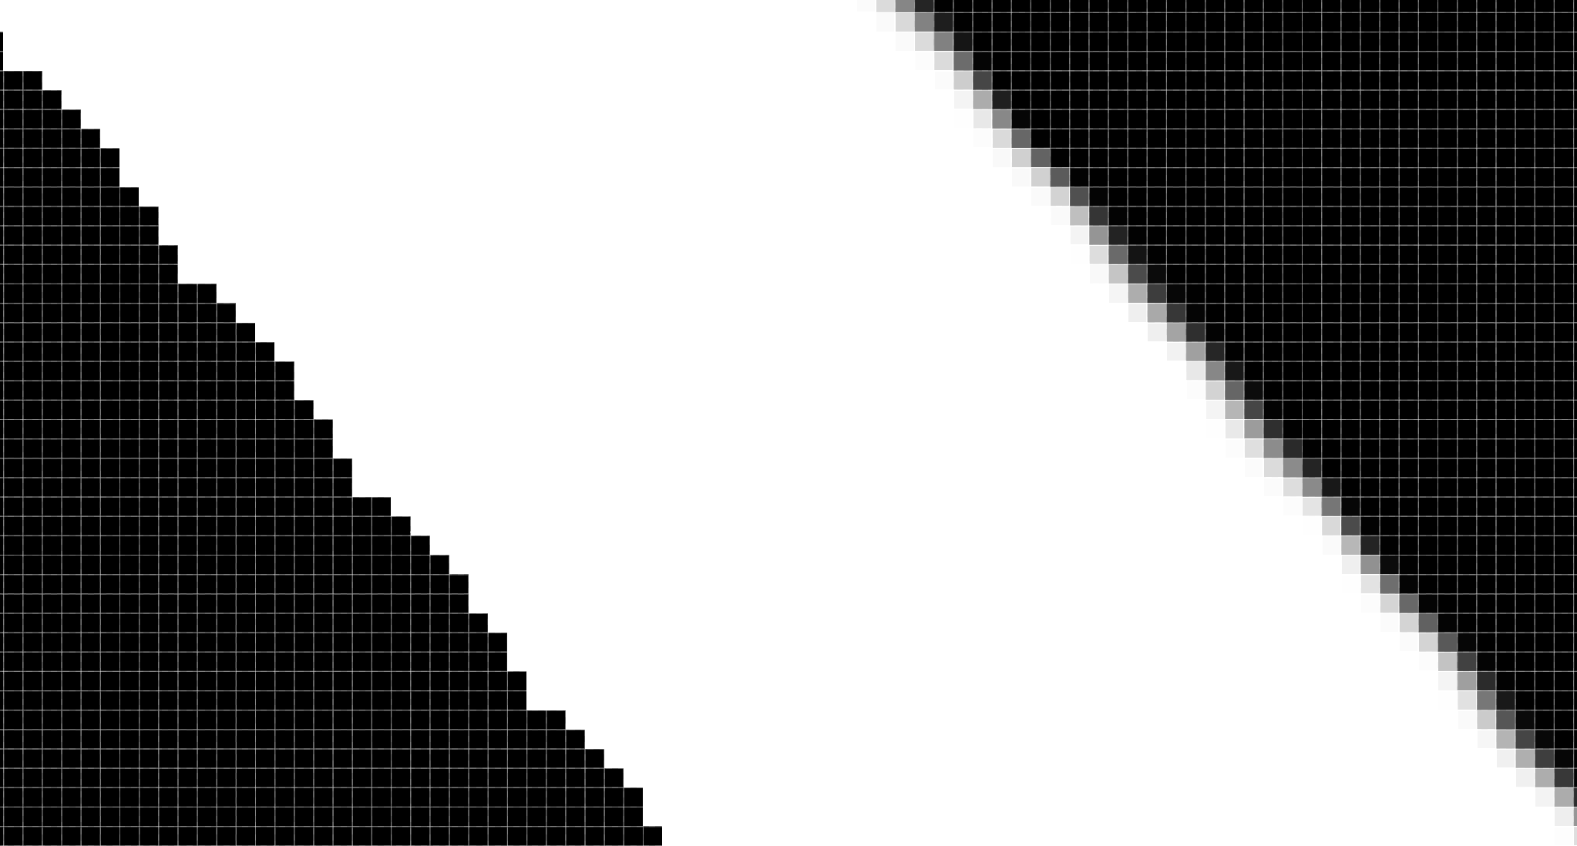
Pixelation Error
Since the resolution of an image is finite, it cannot represent a “perfect” straight line.
The fitting error exists even for perfect line.

Slide 14
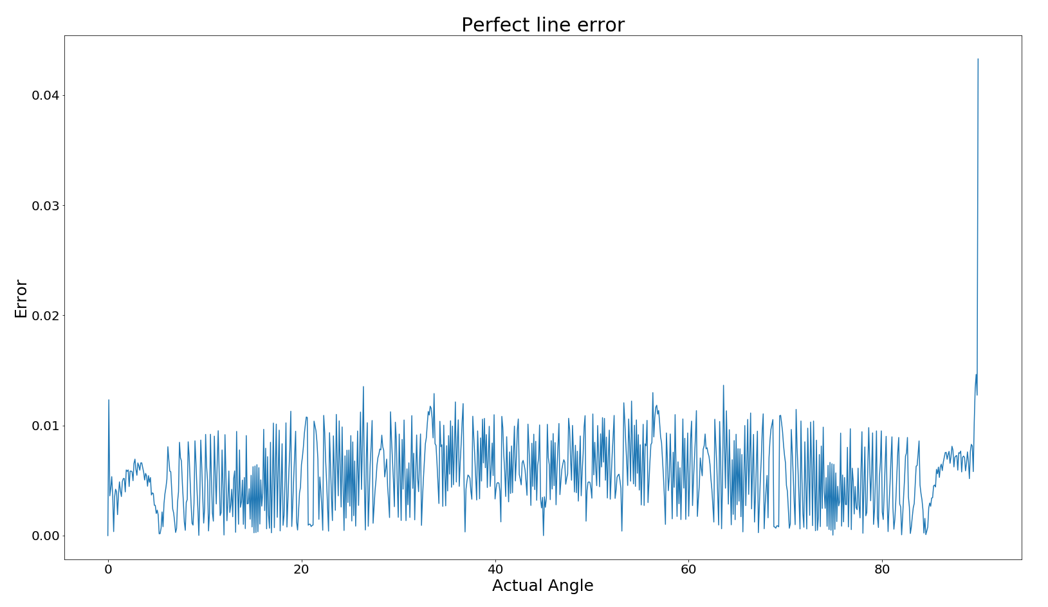
Higher Resolution
The resolution of the camera right now is 2K (2448 * 2048).
The pixel length of the bending part is approximately 500px.
Increase resolution to 4K, pixel length to 1000px.

Slide 15
Future Work
A camera with higher resolution is needed.
Draw lines with different angles and find the number of pixels it intersects with the bend. Choose the one with the largest number.

